Slide 1





Squire
NHA-4-235
Mohamed Akram (Team Leader) • Omar Mowena • Karim Walaa Omar Zalat • Ziad Mohamed • Omar Ghorab

Slide 2


Introduction
🚩 Problem
💡 Solution
Multiple forms
Manual data entry
Interrupted workflow
Time-consuming
Natural language input
AI understands requests
Automatic information extraction
Workflow automation
"From natural language to reliable execution"

Slide 3
Why Squire?
Natural Interaction
Users communicate with the system using everyday language.
Save Time
Reduces manual form filling and navigation.
Intelligent Automation
Automatically schedules meetings and sends reminders.
Reliable Execution
AI understands requests, while predefined workflows execute actions safely.

Slide 4

Key Features
Task Management
Meeting Management
Note Management
Progress Tracking
Google Calendar
Email Notifications

Slide 5
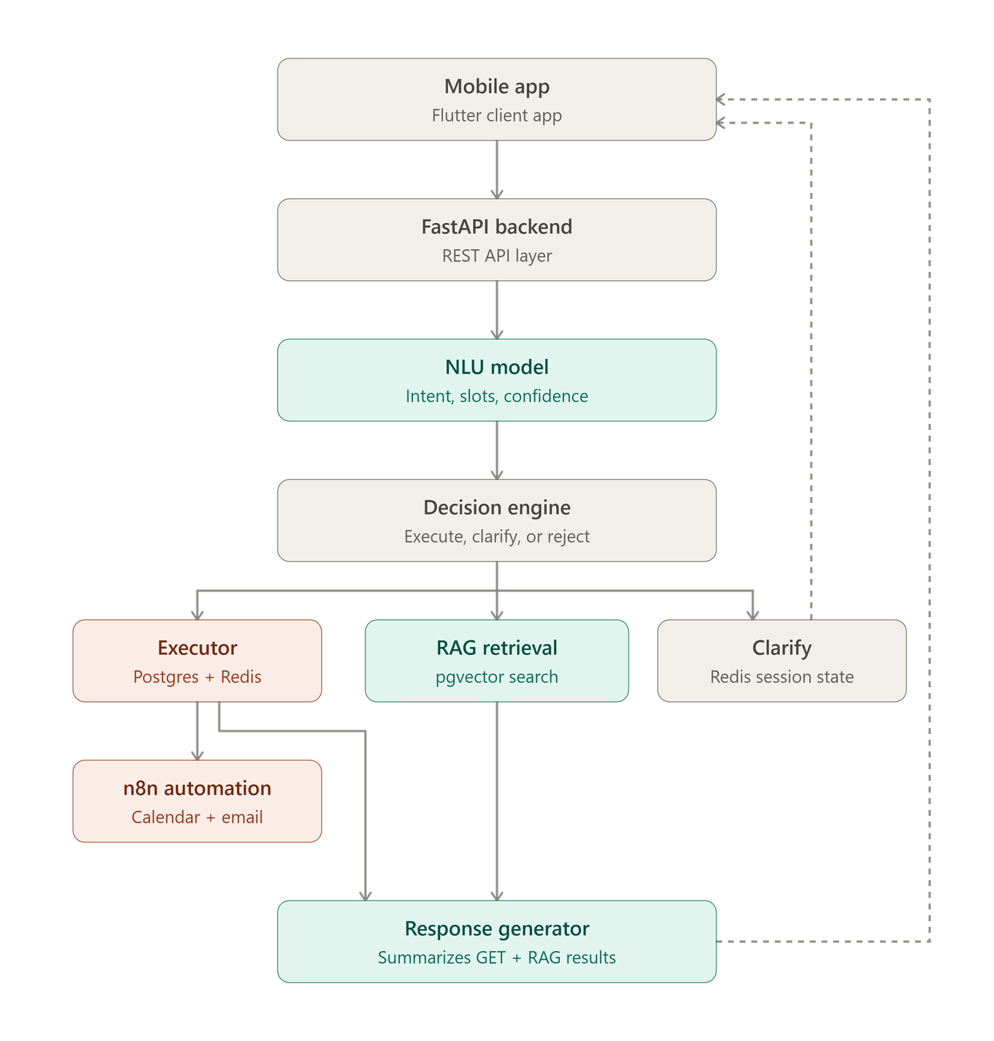
System Architecture

Slide 6
Dataset Source & Description
Custom Productivity Dataset
Manually created and annotated
Designed for productivity management
Adapted samples from benchmark NLU datasets:
ATIS
SNIPS
TOPv2
BANK77
Language: English
Objects: Task, Meeting, Note, Progress
Intents: ADD, GET, UPDATE, DELETE
Annotation: Intent + Named Entity Recognition (NER)

Slide 7
Model Selection — Why mDeBERTa-v3?
Multilingual Support
Supports 100+ languages, enabling future multilingual expansion without changing the model architecture
Disentangled Attention
Separates word content from relative position, improving contextual understanding for intent classification and entity recognition
Strong NLU Performance
Achieves state-of-the-art results on benchmark NLU tasks, providing accurate and reliable language understanding.

Slide 8
How We Built Our Model
Pretrained Encoder
mDeBERTa-v3 as the shared language encoder
Efficient Fine-Tuning
Lightweight Adapter Layers
Multi-Task Learning
:One model learns three tasks simultaneously
Action Classification
Object Classification
Named Entity Recognition (NER)

Slide 9
Training Strategy
Phase 1 — Efficient Adaptation
Freeze the pretrained encoder
Train Adapter Layers and Prediction Heads
Phase 2 — Domain Adaptation
Unfreeze the last encoder layers
Adapt the language model to the productivity domain
Phase 3 — Joint Optimization
Train all tasks together
Optimize Action, Object, and NER
Use contrastive learning

Slide 10
Model Evaluation
Action
Object
96.3% Accuracy
Macro F1: 96.4%
93.8% Accuracy
Macro F1: 93.9%
NER
Reliability
Micro F1: 89.8%
Precision: 88.1%
Recall: 91.5%
ECE: 2.04%
Embedding Separation: 2.75

Slide 11
Model Optimization (Quantization)
ONNX Conversion
Exported the trained PyTorch model to ONNX for platform independent deployment
INT8 Dynamic Quantization
Reduced model size and memory usage
Improved CPU inference performance with minimal accuracy loss

Slide 12
Database Layer
Unified Database
PostgreSQL + pgvector
the architecture became simpler, easier to maintain, and avoided the complexity of synchronizing data between multiple databases
Structured Data Storage
Stores all productivity information in a relational database

Slide 13
Semantic Search Strategy
Productivity Objects
Semantic search over title embeddings
Finds similar records despite different wording
Knowledge Retrieval
RAG-based retrieval
Retrieves relevant note chunks before response generation

Slide 14
LLM Response Layer
LLM Selection
TinyLlama
?Why TinyLlama
Lightweight and efficient
Optimized for local deployment
Fast response generation
Evaluation
Compared with multiple lightweight LLMs.
Selected the best balance between performance and resource usage.

Slide 15
LLM Response Layer
Controlled Response Generation
Prompt-Based Generation
Task-specific prompt templates
response generation
Grounded Responses
Uses only retrieved application data
No external knowledge
Short and natural responses

Slide 16
Shared Embedding Model
Purpose
Converts text into 384-dimensional semantic embeddings
Shared Across the System
Why a Shared Embedder?
Consistent semantic representation
Simplified maintenance
Reusable across multiple AI components

Slide 17
RAG-Based Knowledge Retrieval
Why RAG for Notes?
Notes contain rich, unstructured information
User Question
↓
Generate Embedding
↓
Semantic Search
↓
Retrieve Relevant Notes
↓
LLM Response
Key Design Decisions
Shared semantic embeddings
pgvector storage
Context-aware LLM responses

Slide 18
Semantic Status Mapping
Purpose
Converts natural language into standardized system statuses
Understands different expressions with the same meaning
Business Value
Flexible user interaction
Consistent data representation
Reduces input ambiguity

Slide 19
Task & Meeting Scheduling Automation
Purpose
Automates Google Calendar events and Gmail alerts via webhook.
Key Features
Task & Meeting scheduling
Automatic reminders
Calendar integration
Email notifications before 6 hour of date
Asynchronous workflow execution

Slide 20
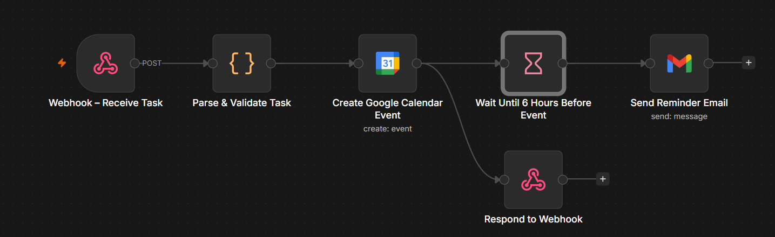
Task & Meeting Scheduling Automation

Slide 21
Thank You

